Slide 1
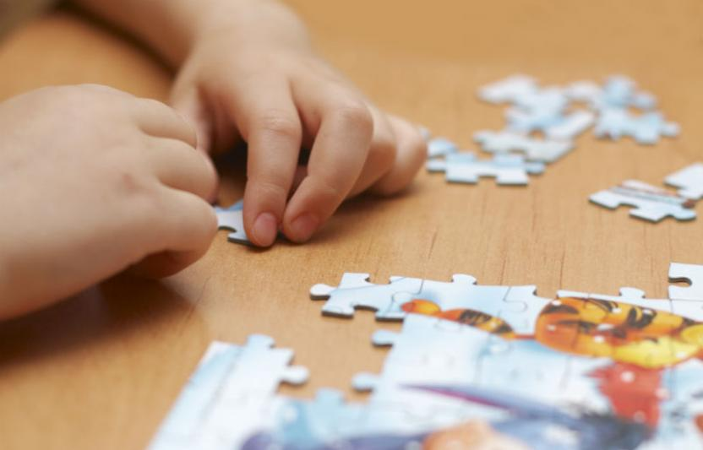



Grades 6-8 BCML Session 7
Building a Culture of Math Learning, Grades 6-8
Topic 3: Focusing on SMP 4
Session 7: Shared Learning

Slide 2
Content Cycle Overview
Building a Culture of Math Learning
The Standards for Mathematical Practice support a culture of math learning where students feel empowered to take academic risks, persevere in problem solving, make meaning of mathematics, explain their thinking, and reflect on their own learning.
12-week Content Cycle
Introduction to the Standards for Mathematical Practice (SMPs) | SMP 1: Make sense of problems and persevere in solving them. | SMP 4: Model with mathematics. | SMP 3: Construct viable arguments and critique the reasoning of others.
Week 1: Shared Learning Week 2: Planning & Practice Week 3: Student Progress | Week 1: Shared Learning Week 2: Planning & Practice Week 3: Student Progress | Week 1: Shared Learning Week 2: Planning & Practice Week 3: Student Progress | Week 1: Shared Learning Week 2: Planning & Practice Week 3: Student Progress
2

Slide 3


Norms
Our Norms
Add your school or team norms here
3

Slide 4
Objectives
Agenda
Internalize the language and look-fors of SMP 4 and draw connections between SMP 4 competencies and increased student access to conceptual understanding
Analyze specific teacher planning and instructional moves around incorporating SMP 4 within the lesson and the impact on student learning
Revisit SMP 4
Create an exemplar student response to a task by determining the target of the standard
Observe teacher moves in utilizing SMP 4 to increase student access to conceptual understanding
Reconnect to our “Why” - Equity
Reflect on Criteria for Success
Closing and next steps
4

Slide 5

Preview Criteria for Success
These are the look-fors we will be focusing on during Topic 3.
As we go through the session, identify connections between today’s learning and progress toward these look-fors.
Handout 1 - Page 5
5

Slide 6
Focusing on SMP 4
SMP 4: Model with mathematics.
Jot down your key takeaways on SMP 4 from our first shared learning session. What would utilizing SMP 4 look like for students?
Post-it Note
6

Slide 7
SMP 4 Share-Out
Mathematically proficient students can apply the mathematics they know to solve problems arising in everyday life, society, and the workplace.
In middle grades, a student might apply proportional reasoning to plan a school event or analyze a problem in the community.
By high school, a student might use geometry to solve a design problem or use a function to describe how one quantity of interest depends on another.
7
Post-it Note

Slide 8
SMP 4 Share-Out
Mathematically proficient students who can apply what they know are comfortable making assumptions and approximations to simplify a complicated situation, realizing that these may need revision later.
They are able to identify important quantities in a practical situation and map their relationships using such tools as diagrams, two-way tables, graphs, flowcharts and formulas.
They can analyze those relationships mathematically to draw conclusions. They routinely interpret their mathematical results in the context of the situation and reflect on whether the results make sense, possibly improving the model if it has not served its purpose.
8
Post-it Note

Slide 9
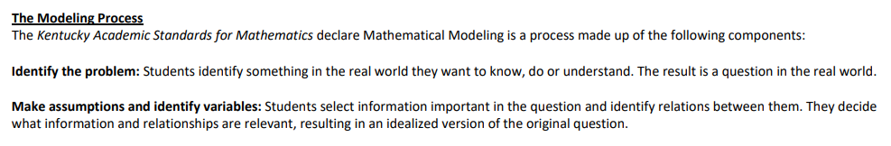
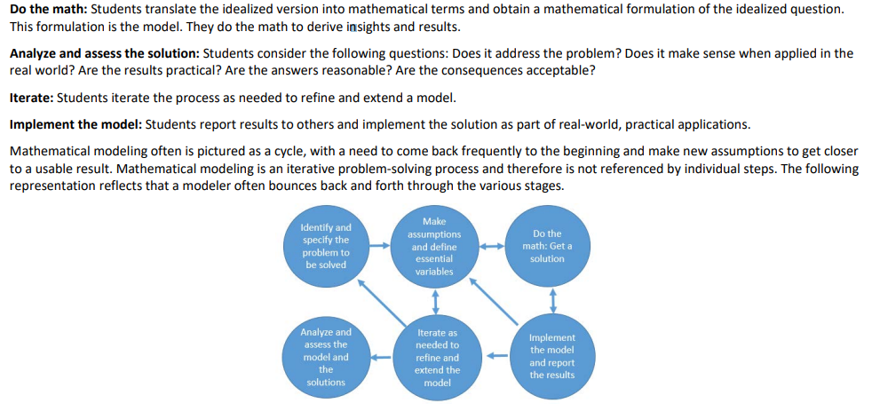
SMP 4 Share-Out
9
Post-it Note

Slide 10
Creating Exemplar Student Responses
Our Process: We’ll be using an annotated version of the Lesson Planning Tool.
Read the KAS for Mathematics and task aloud.
Create exemplar student responses and consider the questions that follow the task.
Handout 1
Handout 2
10

Slide 11
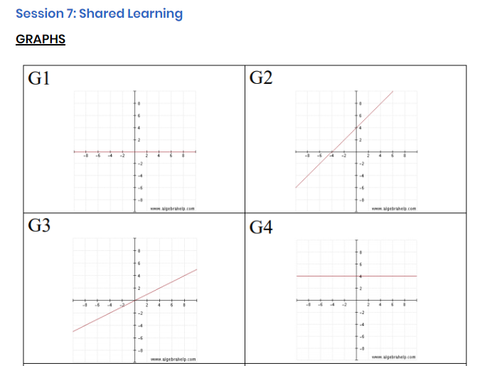
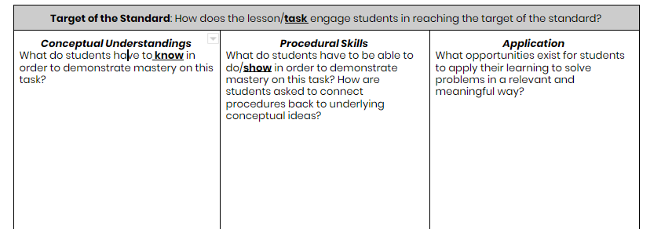
Task Share Out: Grades 6-8
Handout 1
Handout 2
11

Slide 12
SMP 4 in Action: Grades 6-8
Video Observation
Inside Mathematics
Mr. Ragent
Graphs, Equations & Tables
(min 0:00 - 5:30)
Handout 1
12

Slide 13
Video Share Out: Grades 6-8
What planning steps did the teacher take to incorporate these SMP 4 into his instruction?
What instructional moves did the teacher take to incorporate SMP 4 into his lesson? What impact did this have on students?
13

Slide 14
Instructional Share Out: Grades 6-8
In what ways have you already incorporated SMP 4 into your instruction? What does this look like in terms of teacher and student actions?
After watching today’s video and continuing to reflect on your own practice, what might you try next?
With a partner
14

Slide 15
Revising our instructional resources
In the video, the original task presented asked students to create “triples” by matching an equation, graph, and table.
However, the aligned standard KY.8.F.2 calls for representations to be shown “algebraically, graphically, numerically in tables, or by a
verbal description.”
Handout 1
15

Slide 16
Revising our instructional resources
Based on the guiding questions in the Assignment Review Protocol, we can see that the original task as written does not meet the target of the standard, which calls for application to real world contexts.
How was the task revised to align to the target of the standard?
Handout 1
16

Slide 17
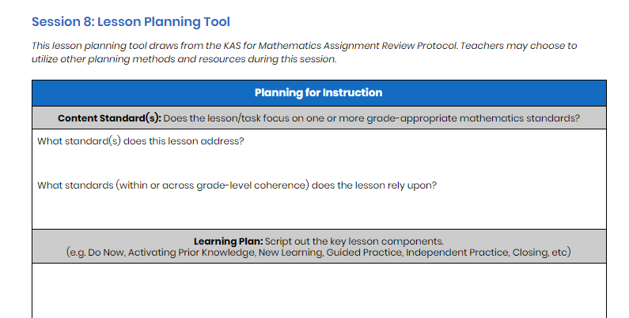
Revising our curriculum and instruction
Think ahead to next week’s session -
Session 8: Planning & Practice.
Post-it
17

Slide 18
Guiding questions for planning
Based on the Assignment Review Protocol, does my lesson/task meet the target of the standard? If not:
Are there conceptual understandings missing? How can I ask students to demonstrate their understanding using representational and abstract (algebraic) methods?
Are there opportunities for application missing? How can I add real world context or real world problems to get students to apply their understanding?
Will students engage in the Mathematical Practices by completing this task? How can offer explicit opportunities within the task and/or during instruction to ensure students meet the practice standards?
18

Slide 19
Reconnecting to our “Why”- Equity
How might explicitly teaching SMP 4 support both mathematical understanding and productive struggle for students, especially our most vulnerable students?
How might SMP 4 help students in accessing the target of the standard and/or task?
Handout 1
19

Slide 20
Criteria for Success
Criteria for Success
Read the teacher and student look-fors found on your handout.
How do these teacher and student look-fors connect to the focus for our learning this cycle?
Are there any look-fors you would add to the list?
Handout 1
20

Slide 21
Reflection and Looking Ahead
Complete the reflection on today’s session learnings, including a possible application of this learning to upcoming planning and instruction.
Handout 1
21

Slide 22
Closing Whip Around
Closing Whip Around
How might you explicitly teach students SMP 4 in an upcoming lesson?
How will you integrate SMP 4 so that it supports the mathematical content of the lesson, instead of isolated concepts or skills?

Slide 23
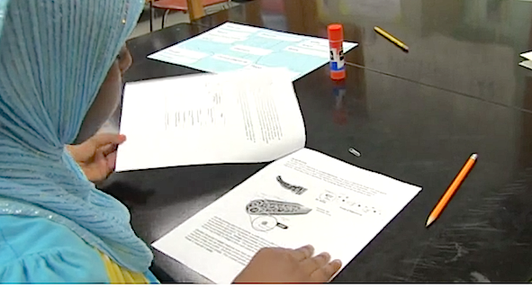
What’s Next
What's Next?
Session 8: Planning and Practice
Identify the implementation characteristics of SMP 4 and apply to planning and practice
Give and receive feedback from colleagues in order to revise plans and refine practices
23
23

